Slide 1
Synthesizing Audio using Generative Adversarial Networks CMSC727 Project
Bowen Zhi
Fan Yang
Patrick Owen
Nadee Seneviratne

Slide 2
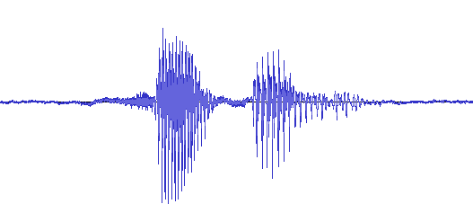


Problem Statement
Unsupervised audio generation
Given: audio samples drawn from unknown distribution $Ρ_{R}$
Goal: generative model that approximates $Ρ_{R}$

Slide 3
Applications
Music production
Text-to-speech
Data augmentation
Sound design

Slide 4
Generative Adversarial Networks
Generator: maps latent space -> data space
Recently used for unsupervised image generation (e.g. DCGAN [1], BEGAN [2])
Unsupervised audio generation: relatively unexplored
[1] Radford et. al, ICLR 2016.
[2] Brethelot et. al, 2017.

Slide 5
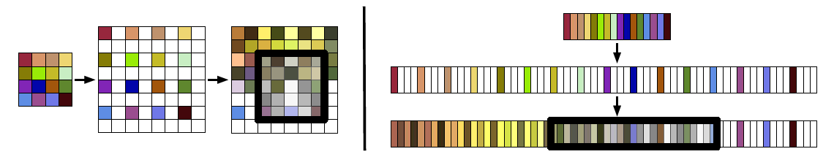
Adversarial Audio Synthesis Donahue et. al, 2018 (ICLR 2019 submission)
Adapt DCGAN architectures to audio
fixed-size images -> fixed-length audio clips
WaveGAN: DCGAN on raw waveforms
5x5 2D convolutions -> 25x1 1D convolutions
Image taken from: https://arxiv.org/pdf/1802.04208.pdf

Slide 6
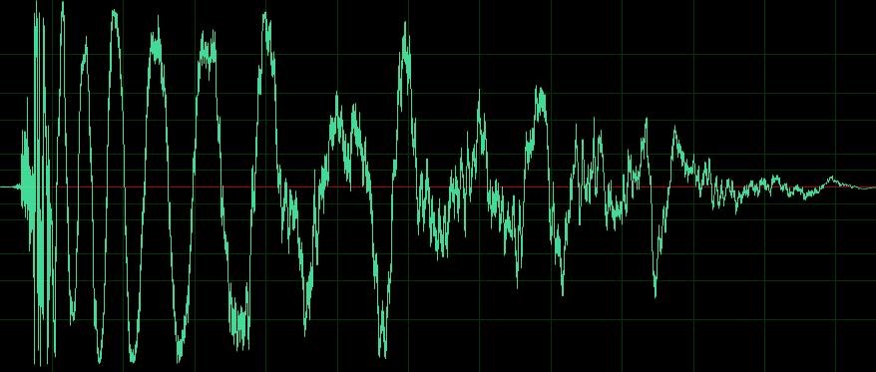
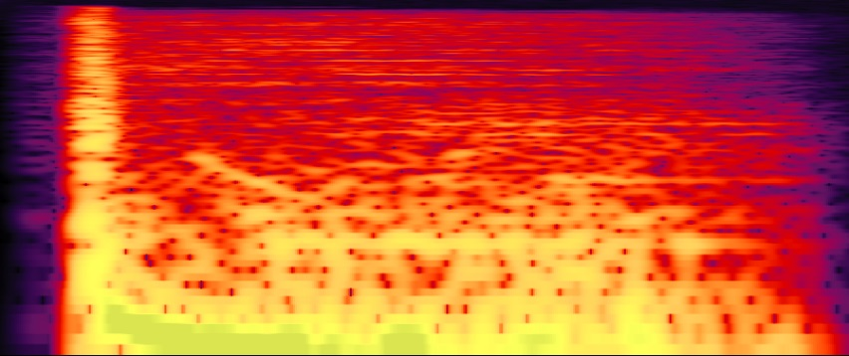
Adversarial Audio Synthesis Donahue et. al, 2018 (ICLR 2019 submission)
Adapt DCGAN architectures to audio
fixed-size images -> fixed-length audio clips
WaveGAN: DCGAN on raw waveforms
SpecGAN: DCGAN on audio spectrograms

Slide 7
Adversarial Audio Synthesis Donahue et. al, 2018 (ICLR 2019 submission)
Adapt DCGAN architectures to audio
fixed-size images -> fixed-length audio clips
WaveGAN: DCGAN on raw waveforms
SpecGAN: DCGAN on audio spectrograms
spectrograms: time-frequency representation
non-invertible (phase info lost)
approximate inverse: Griffin-Lim [1]
degrades audio quality
[1] Griffin & Lim, IEEE Trans. Acoust., Speech, Signal Process. 1984.

Slide 8
Adversarial Audio Synthesis Donahue et. al, 2018 (ICLR 2019 submission)
Adapt DCGAN architectures to audio
fixed-size images -> fixed-length audio clips
WaveGAN: DCGAN on raw waveforms
SpecGAN: DCGAN on audio spectrograms
Findings:
training methods: WGAN-GP loss [4] works best
compared to traditional GAN [1], LSGAN [2], WGAN [3] losses
quantitative results: SpecGAN > WaveGAN
qualitative results: WaveGAN > SpecGAN
[1] Radford et. al, ICLR 2016.
[2] Mao et. al, ICCV 2017.
[3] Arjovsky et. al, ICML 2017.
[4] Gulrajani et. al, NIPS 2017.

Slide 9
Audio Representations
To address the problem of generating audio clips consisting of 16384 samples, at a sample rate of 16 kHz.
Representations which helps to retain phase information.
A fixed transformation is applied to all input audio data, and its inverse is applied to the generator output to produce audio signals.
Short-time Fourier Transform (STFT)
Short-time Discrete Cosine Transform (STDCT)
Data Scaling And Normalization
The magnitudes of the DFT and DCT outputs are scaled logarithmically both to simulate human auditory perception and to better bound the range of values
Further, the magnitudes of the data are rescaled to [-1,1] on a per-frequency basis

Slide 10
Short-time Fourier Transform (STFT)
Taking Fourier transformation for short time frames of the audio signal
Hann windows of length 256 with a stride of 128 samples
Zero-pad the boundaries: For complete reconstruction
This yields 256 complex values for each of the 129 windows
Real signal -> Hermitian symmetry -> discard upper 127 frequencies
Time and frequency dimensions as a 2D spatial grid: a single-channel complex-valued image of shape (129, 129, 1)
Separate the real and imaginary components into individual channels: an equivalent real image of shape (129, 129, 2)
Final image has shape (128, 128, 2)
Nyquist Frequency discarded -> 128 Frequencies
To preserve equal spatial dimensions, number of time windows were reduced to 128

Slide 11
Short-time Discrete Cosine Transform (STDCT)
Type-II DCT:
computes the DFT of a signal’s even extension.
Hann windows of length 256 with a stride of 64 samples
still maintains the constant overlap-add property.
Discard the zero-padded windows at the end to yield a real image of shape (256, 256, 1)

Slide 12
Proposed GAN Architectures
Modified SpecGAN generator and discriminator architectures
DFT GAN
Generator output and discriminator input to have 2 channels
Kernel weights are initialized using Glorot uniform initialization for the output layers of both generator and discriminator, He uniform initialization for all other operations.
All layers also have biases, which are zero-initialized.
DCT GAN
Additional transposed convolution layer at the end of the Generator, beginning of the Discriminator
This allows the generator’s output and discriminator’s input to have the correct dimensions for our DCT representation
Weights and biases are initialized as in DFT GAN

Slide 13
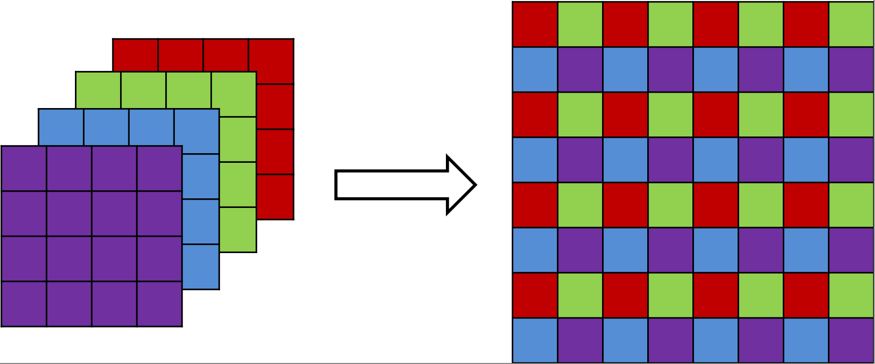
Sub-Pixel (SP) Convolution
Alternative to transpose convolutions [1]
As transpose convolutions are prone to producing “checkerboard” artifacts [2]
Regular convolutions followed by “sub-pixel shuffling”
[1] Shi et. al, CVPR 2016.
[2] Aitken et. al, 2017.

Slide 14
Proposed GAN Architectures (cont.)
DFT-SP GAN and DCT-SP GAN
Copy the architectures for the DFT and DCT GANs and replace the 5×5 stride-2 transpose convolutions of the generators with 3×3 sub-pixel convolutions.
Same effective receptive field as the replaced transpose convolutions

Slide 15
Dataset
Speech Commands Zero Through Nine (SC09)
Introduced by baseline paper [1]
1850 recordings of each digit, each recording is one second in length
wide variety of alignments, speakers and recording conditions
a challenging dataset from a generative perspective
[1] Donahue et. al, 2018

Slide 16

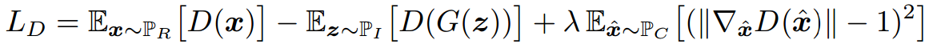
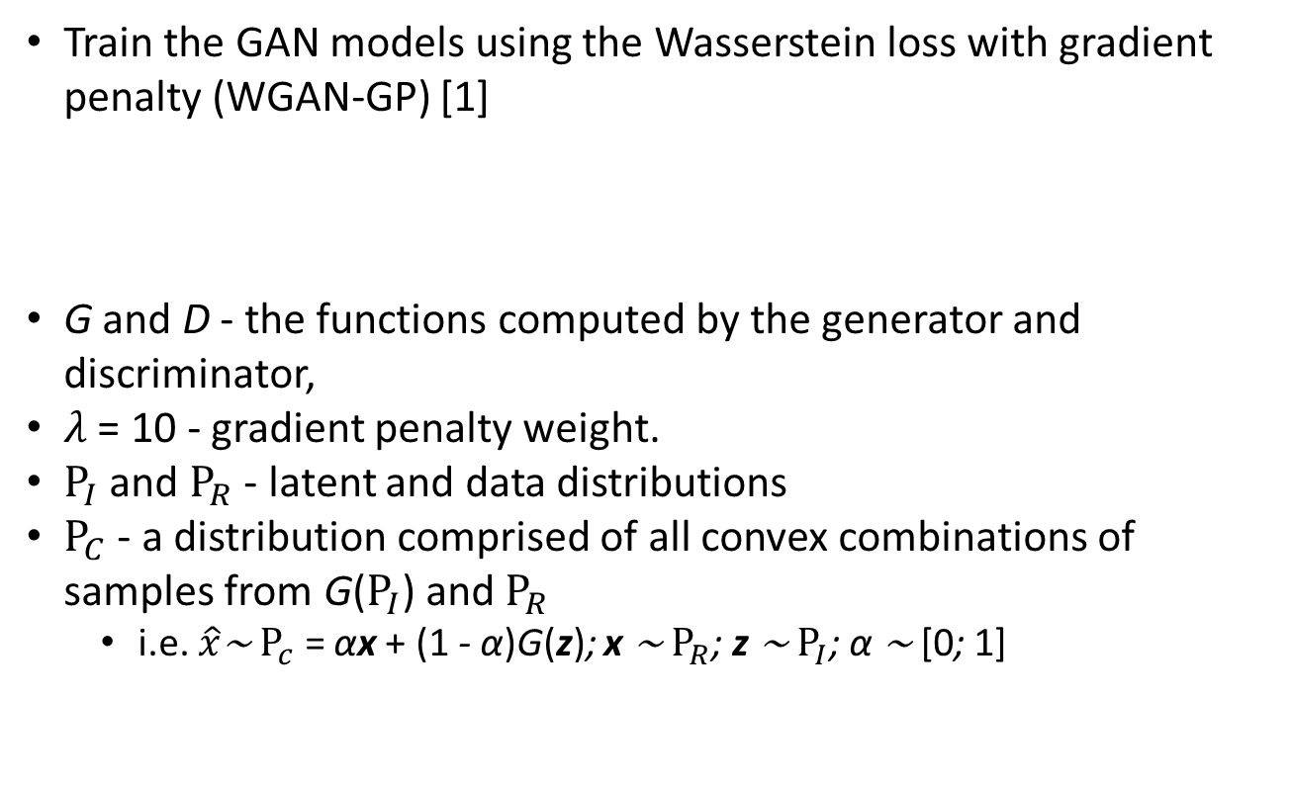
Training Configuration
Train the GAN models using the Wasserstein loss with gradient penalty (WGAN-GP) [1]
G and D - the functions computed by the generator and discriminator,
$λ$ = 10 - gradient penalty weight.
$Ρ_{I}$ and $Ρ_{R}$ - latent and data distributions
$Ρ_{C}$ - a distribution comprised of all convex combinations of samples from G($Ρ_{I}$) and $Ρ_{R}$
i.e. $\hat{x}$∼ $Ρ_{c}$ = αx + (1 - α)G(z); x ∼ $Ρ_{R}$; z ∼ $Ρ_{I}$; α ∼ [0; 1]
[1] Gulrajani et. al, NIPS 2017.

Slide 17
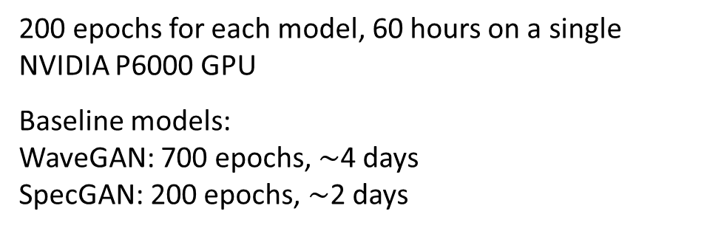
Training Configuration (cont.)
Adam Optimizer
$α$= 1e−4, $β_{1}$= 0.5, $β_{2}$= 0.9
Training time
200 epochs for each model, 60 hours on a single NVIDIA P6000 GPU
Baseline models:
WaveGAN: 700 epochs, $\sim$4 days
SpecGAN: 200 epochs, $\sim$2 days

Slide 18


Evaluation Metrics
Inception score
measures both the quality and the inter-class diversity of the generated audio
does not penalize overfitting and within-class homogenization
Nearest neighbor comparison
measures the average L2 distance of a set of 1K examples to their nearest neighbor within the set.
value close to 0 means no within-class diversity (one sound for each class)
measures the average L2 distance of a set of 1K examples to their nearest neighbor in the real training data.
value close to 0 means memorization of training data (overfitting)

Slide 19
Evaluation Metrics
Subjects were asked to assess 10 audio samples generated by each of our four models, with respect to three metrics: sound quality, ease of intelligibility, and speaker diversity
As a control, subjects are also asked to rate 10 randomly-selected audio samples from the SC09 test set
Ratings are on a 0-10 scale, higher is better

Slide 20
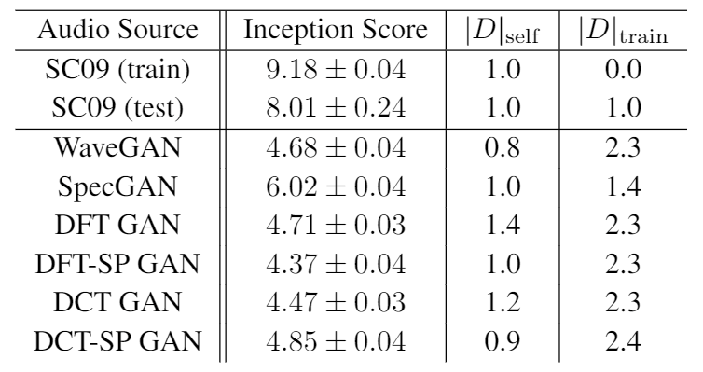
Quantitative Results

Slide 21
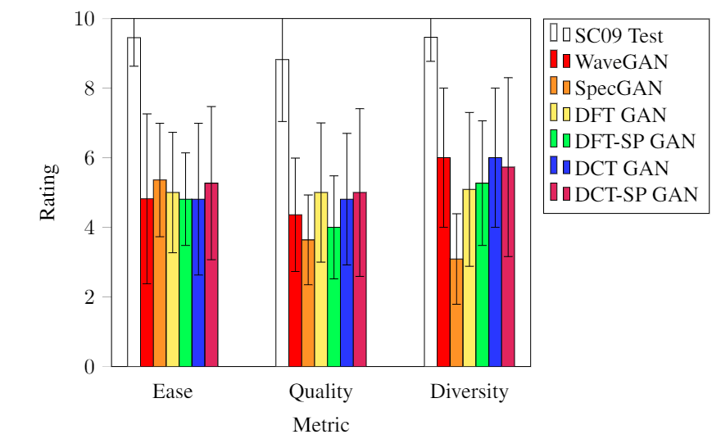
Qualitative Results
Proposed models improve upon SpecGAN, comparable with WaveGAN
less training time; better suited for learning?
not completely conclusive (N = 11)

Slide 22



Sound Demos
Examples: “five”
Failure cases: non-words
Failure cases: noise
DCT-SP GAN
SpecGAN
WaveGAN
DCT-SP GAN
SpecGAN
WaveGAN
DCT-SP GAN
SpecGAN
WaveGAN

Slide 23
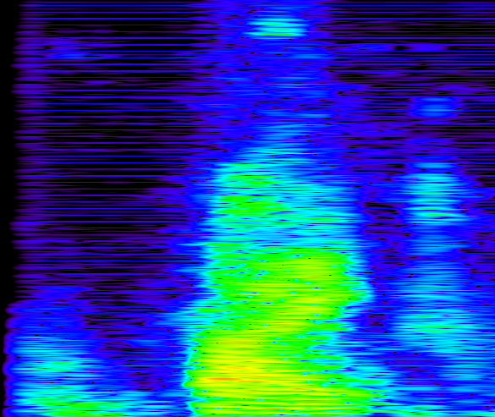
Artifacts
“Buzzing”
DFT-SP
DCT
DCT-SP
Impulses
multiples of window hop size
Removing bias?
did not remove the buzzing

Slide 24
Future Work
Further investigate cause of buzzing artifact
Experiment with more models
Subpixel shuffling with WaveGAN
Train with different kinds of audio
Sound effects
Musical instruments
Multi-resolution methods
LAPGAN [1], progressive growth [2]
Higher quality audio
Complex neural networks [3]
[1] Denton et. al, NIPS 2015.
[2] Karras et. al, 2017.
[3] Trabelsi et. al, ICLR 2018.

